Slide 1


ADVANCED INTEGRATED RESPONSE & AID ASSISTANT
Rapid response for any emergency, anywhere

Slide 2
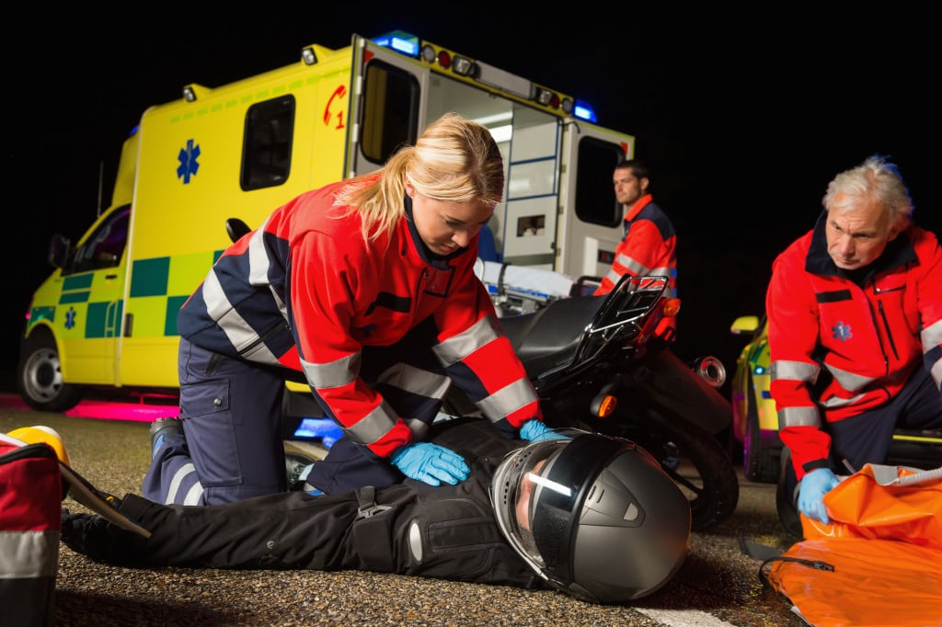
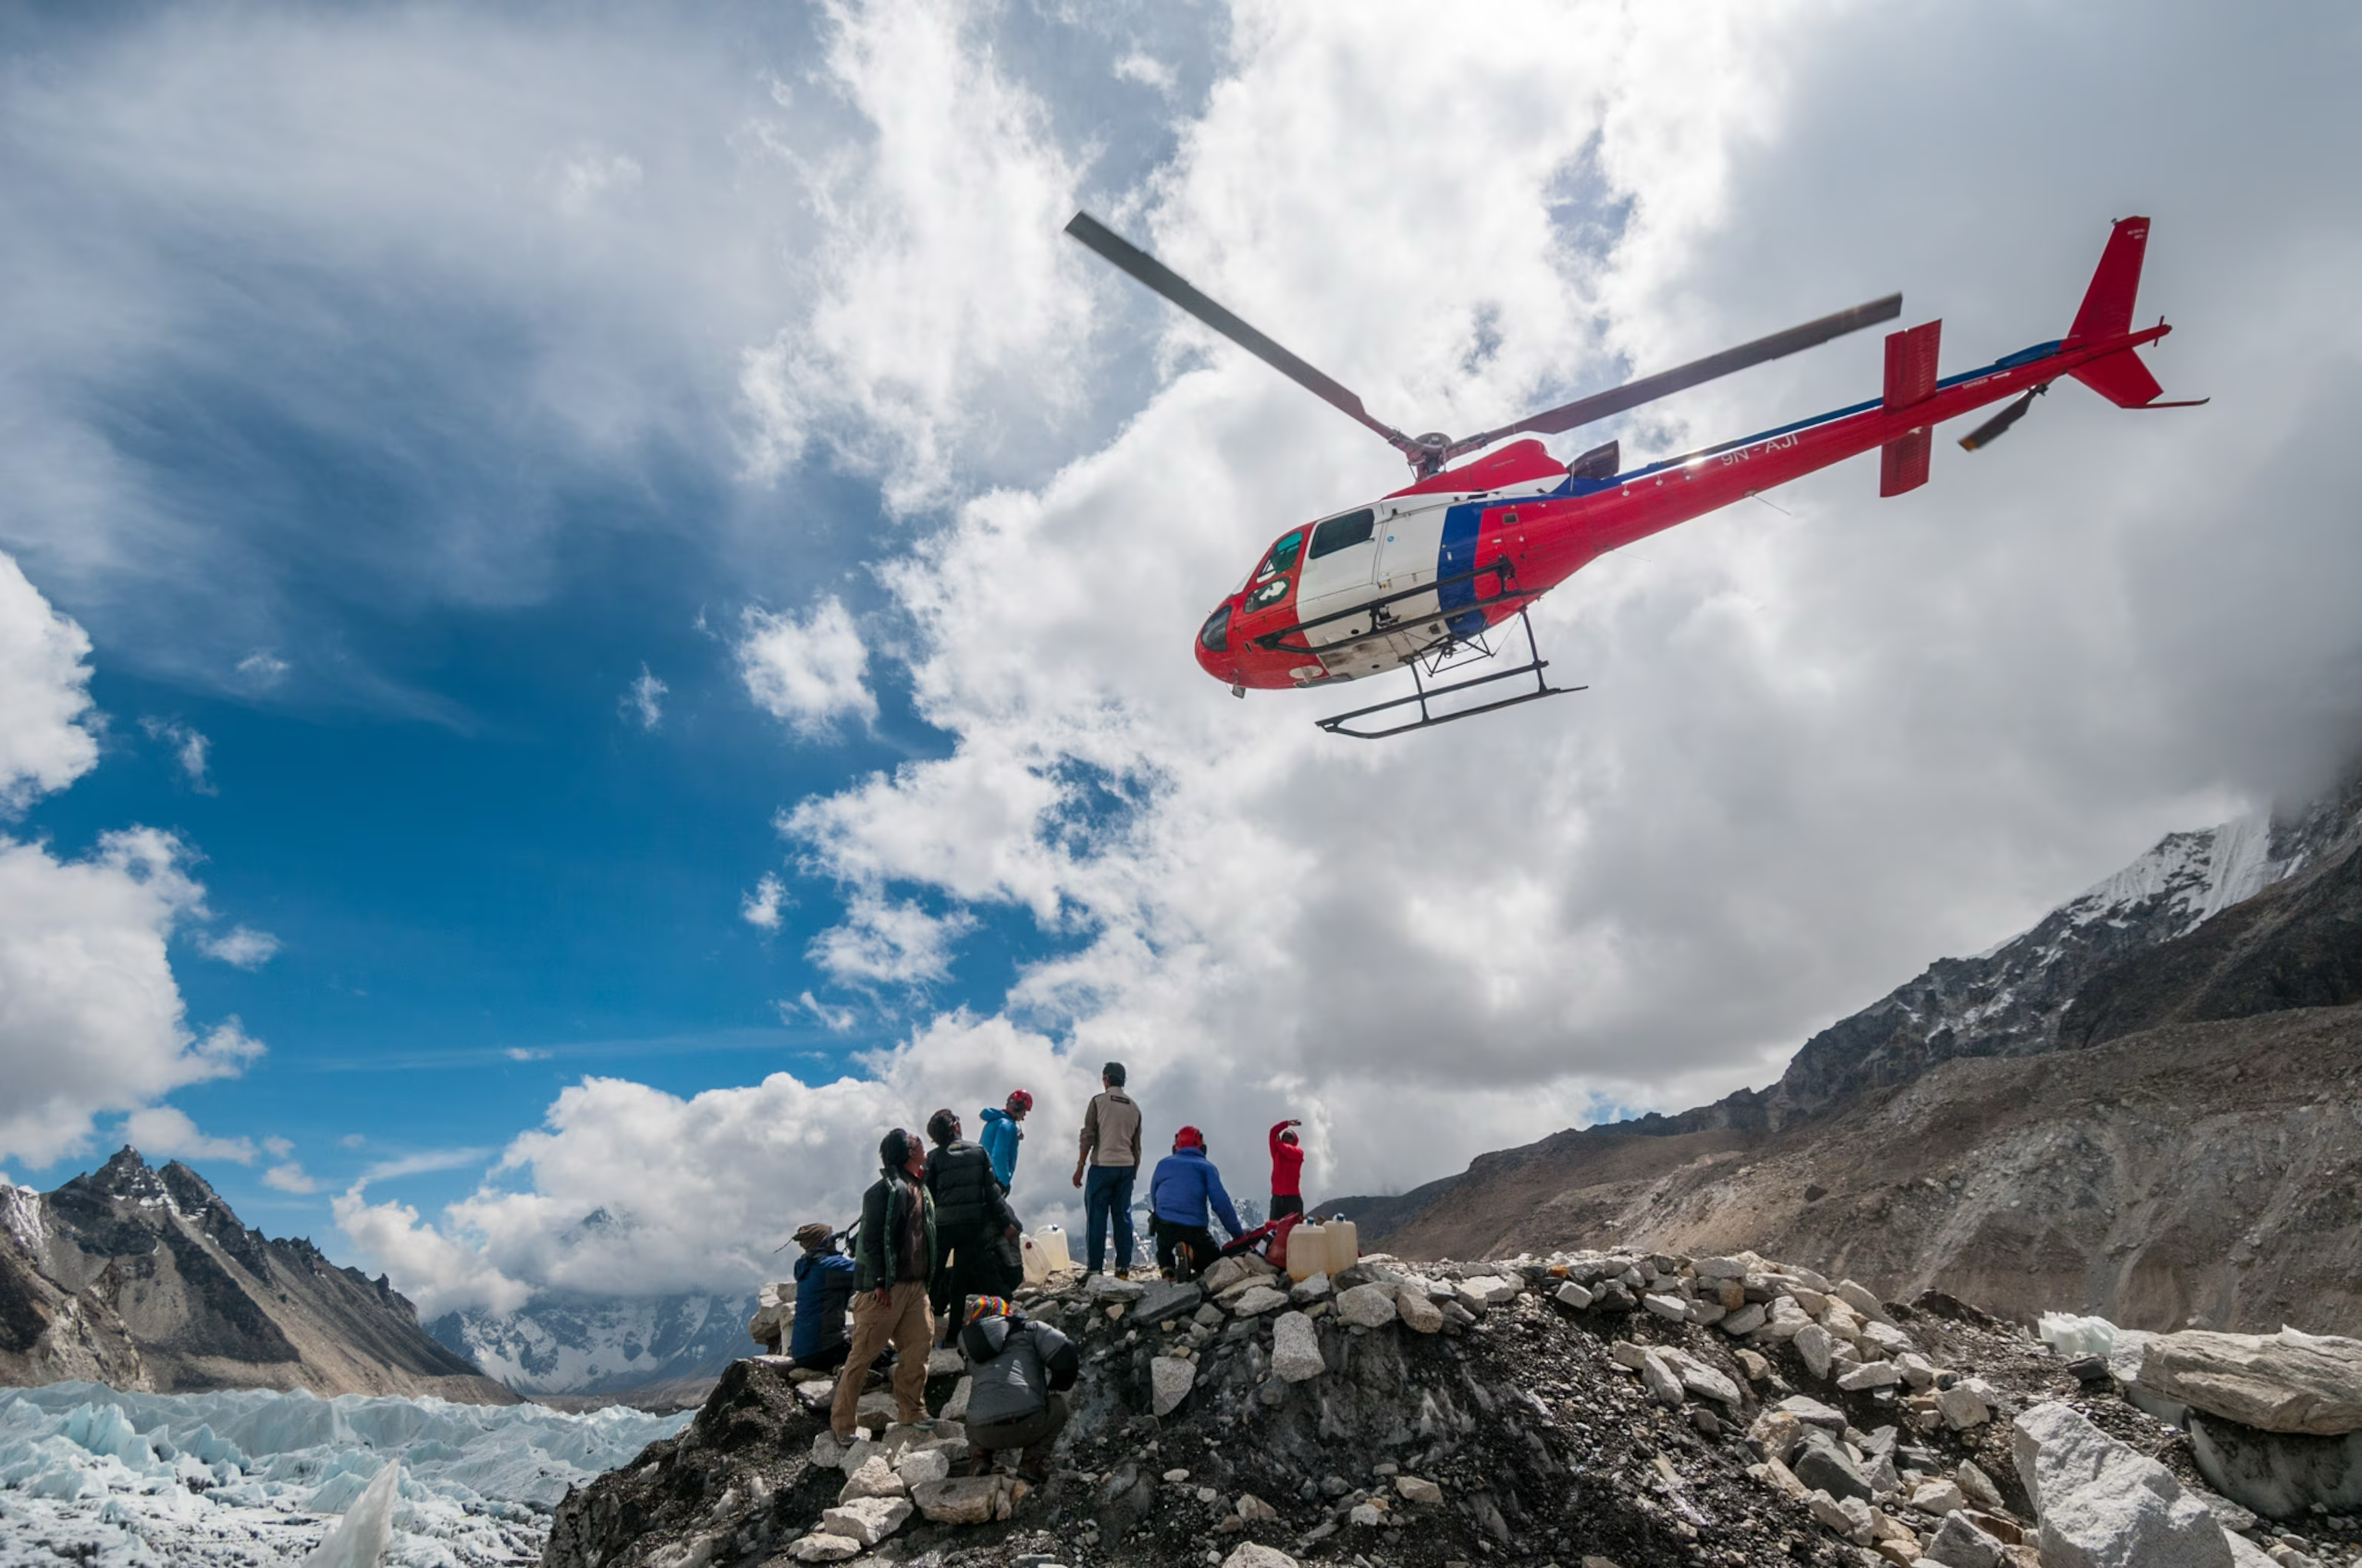
Goal: Reduce Response Time of Rescues and First Aid
SAVE MORE LIVES

Slide 3
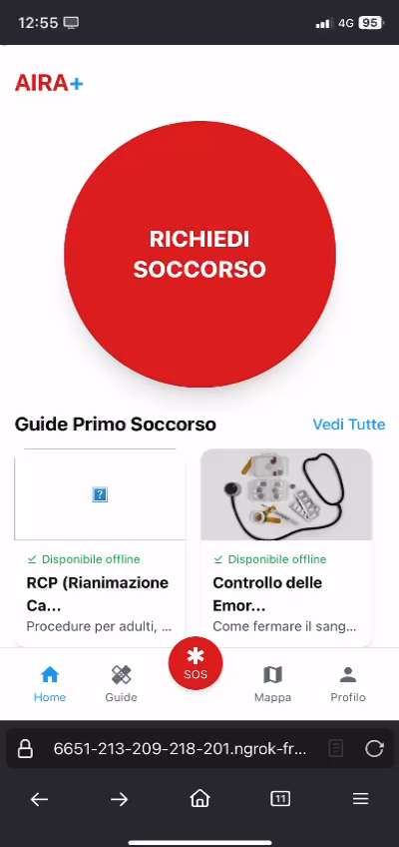
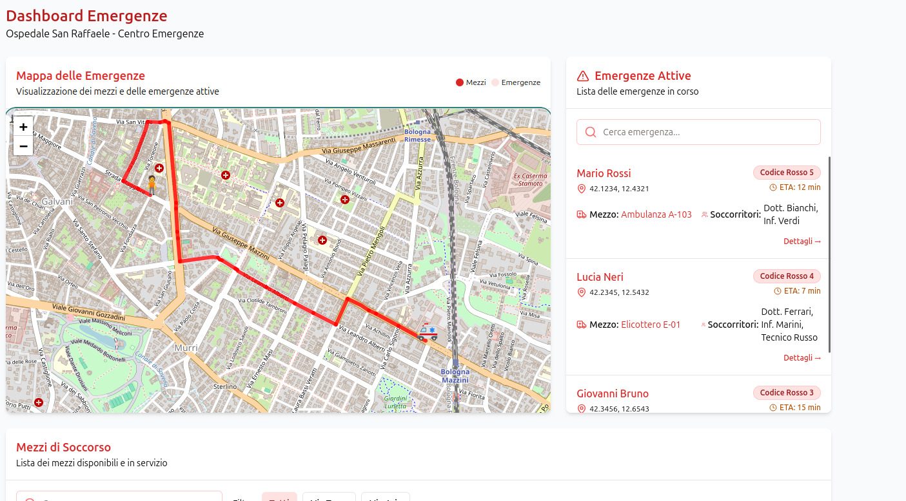
Our 2-in-1 Solution
MOBILE APP
ADMIN PANEL

Slide 4
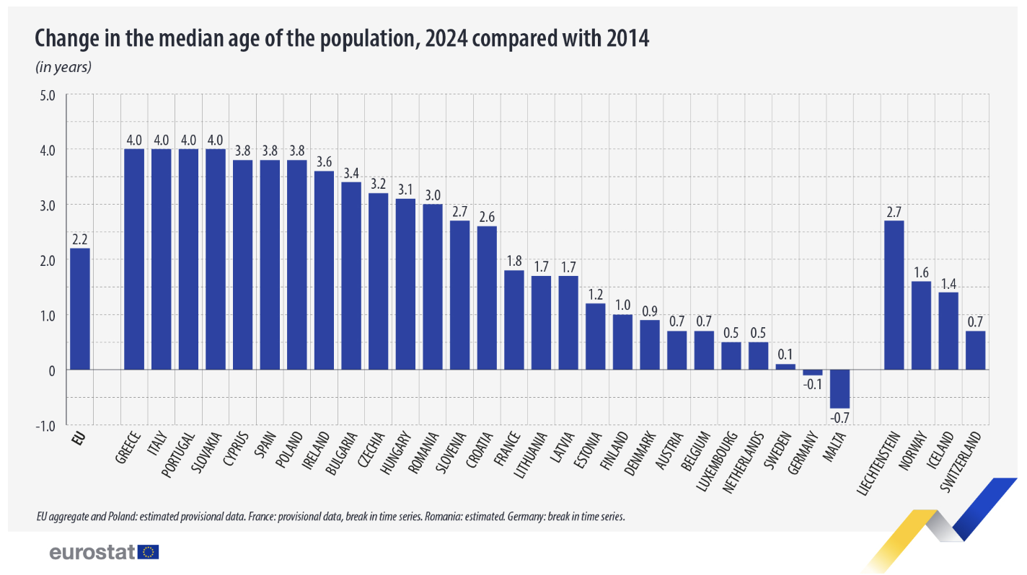
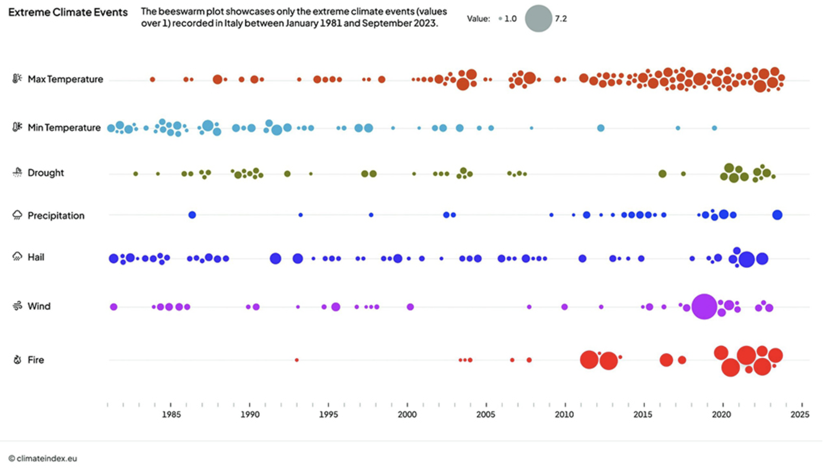
World Trends: Aging Population and Climate Change
AGING EUROPEAN POPULATION | +2.2 YEARS 2014-2024
CLIMATE-RELATED EVENTS GROWTH | ITALY 1981-2023

Slide 5
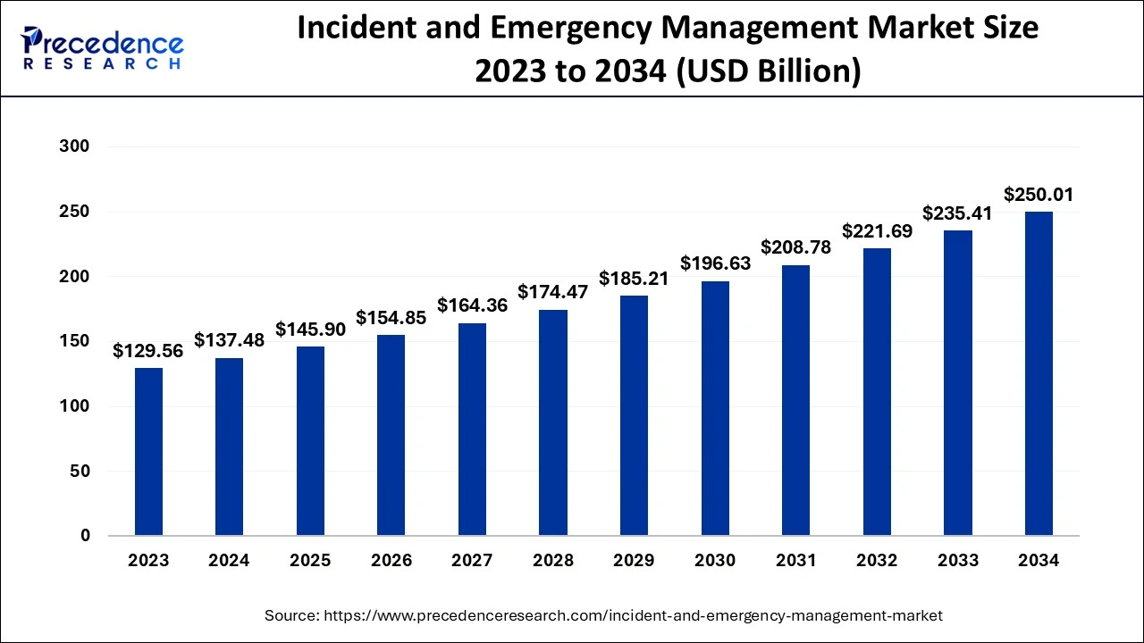
Emergency Market Size: Opportunity
200+ Billion $ Market by 2034
+85% Market Growth in 10 Years

Slide 6
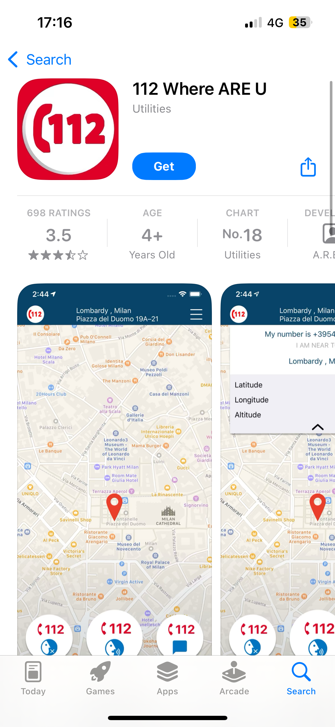
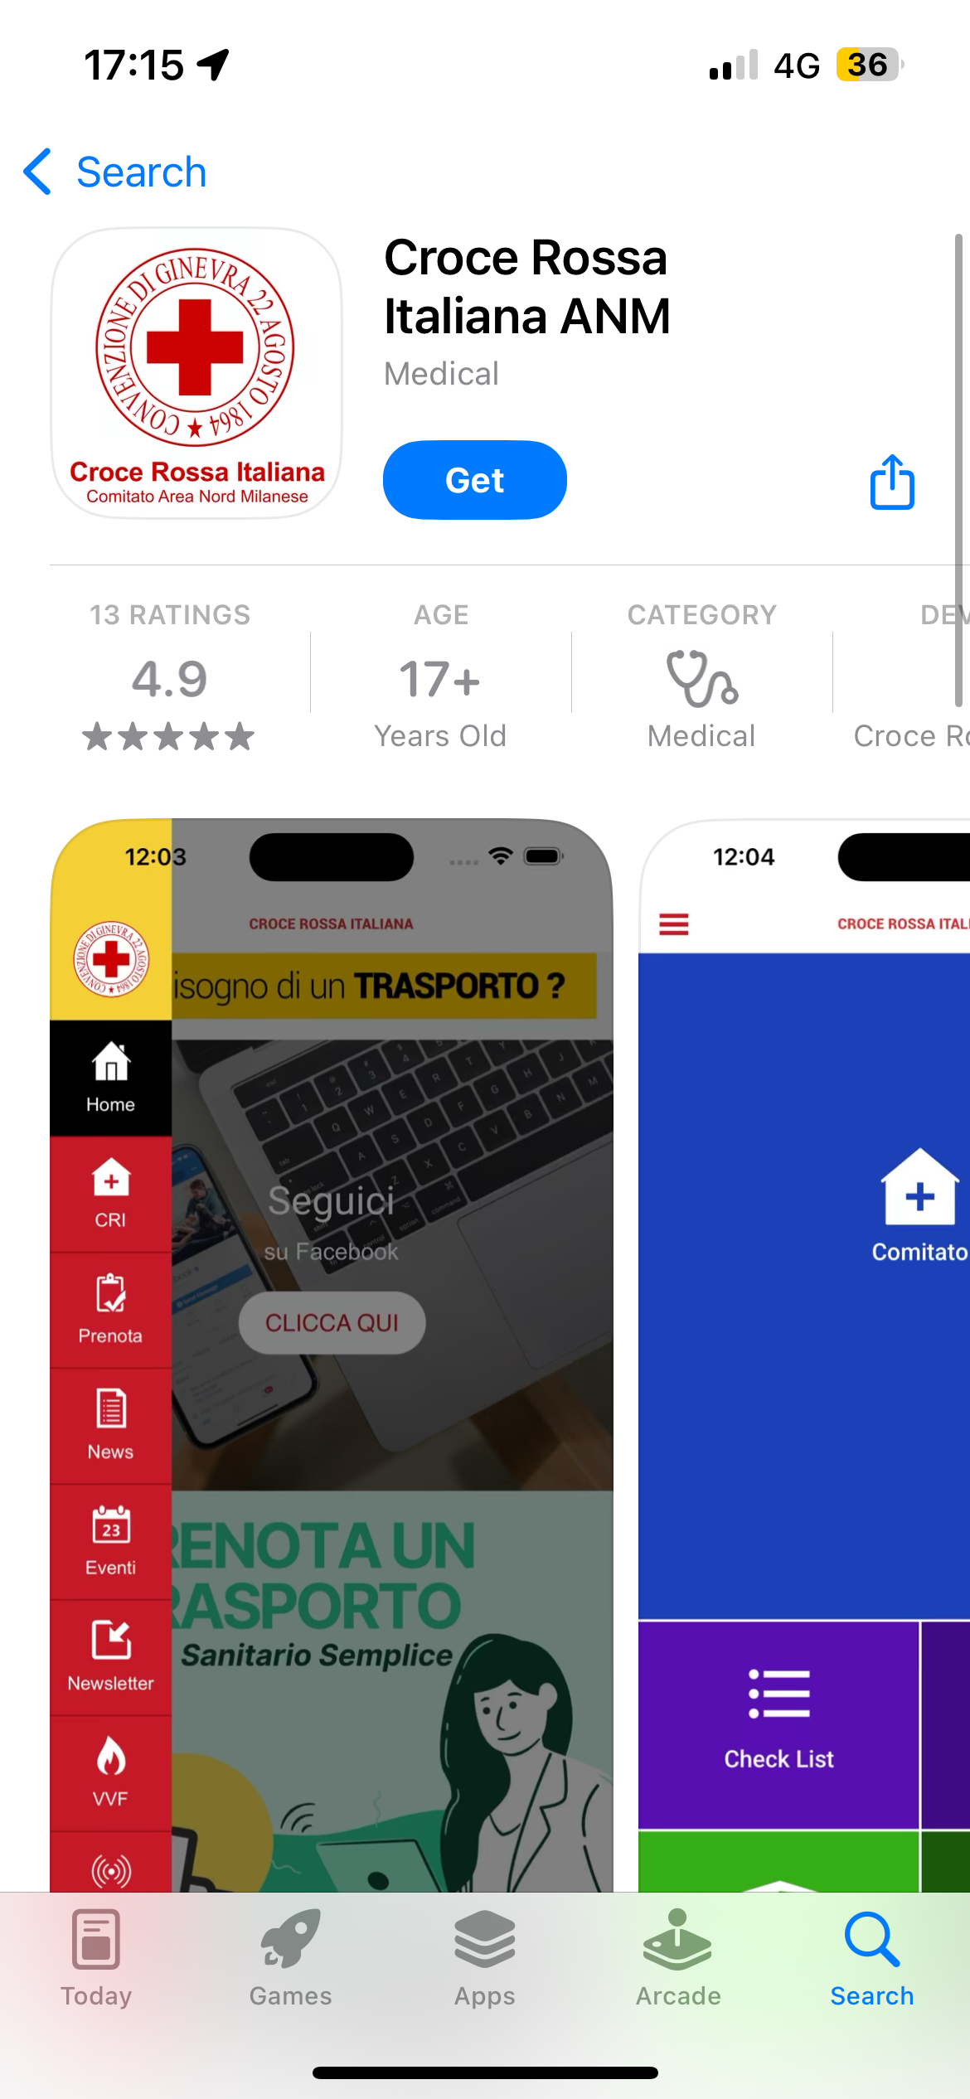
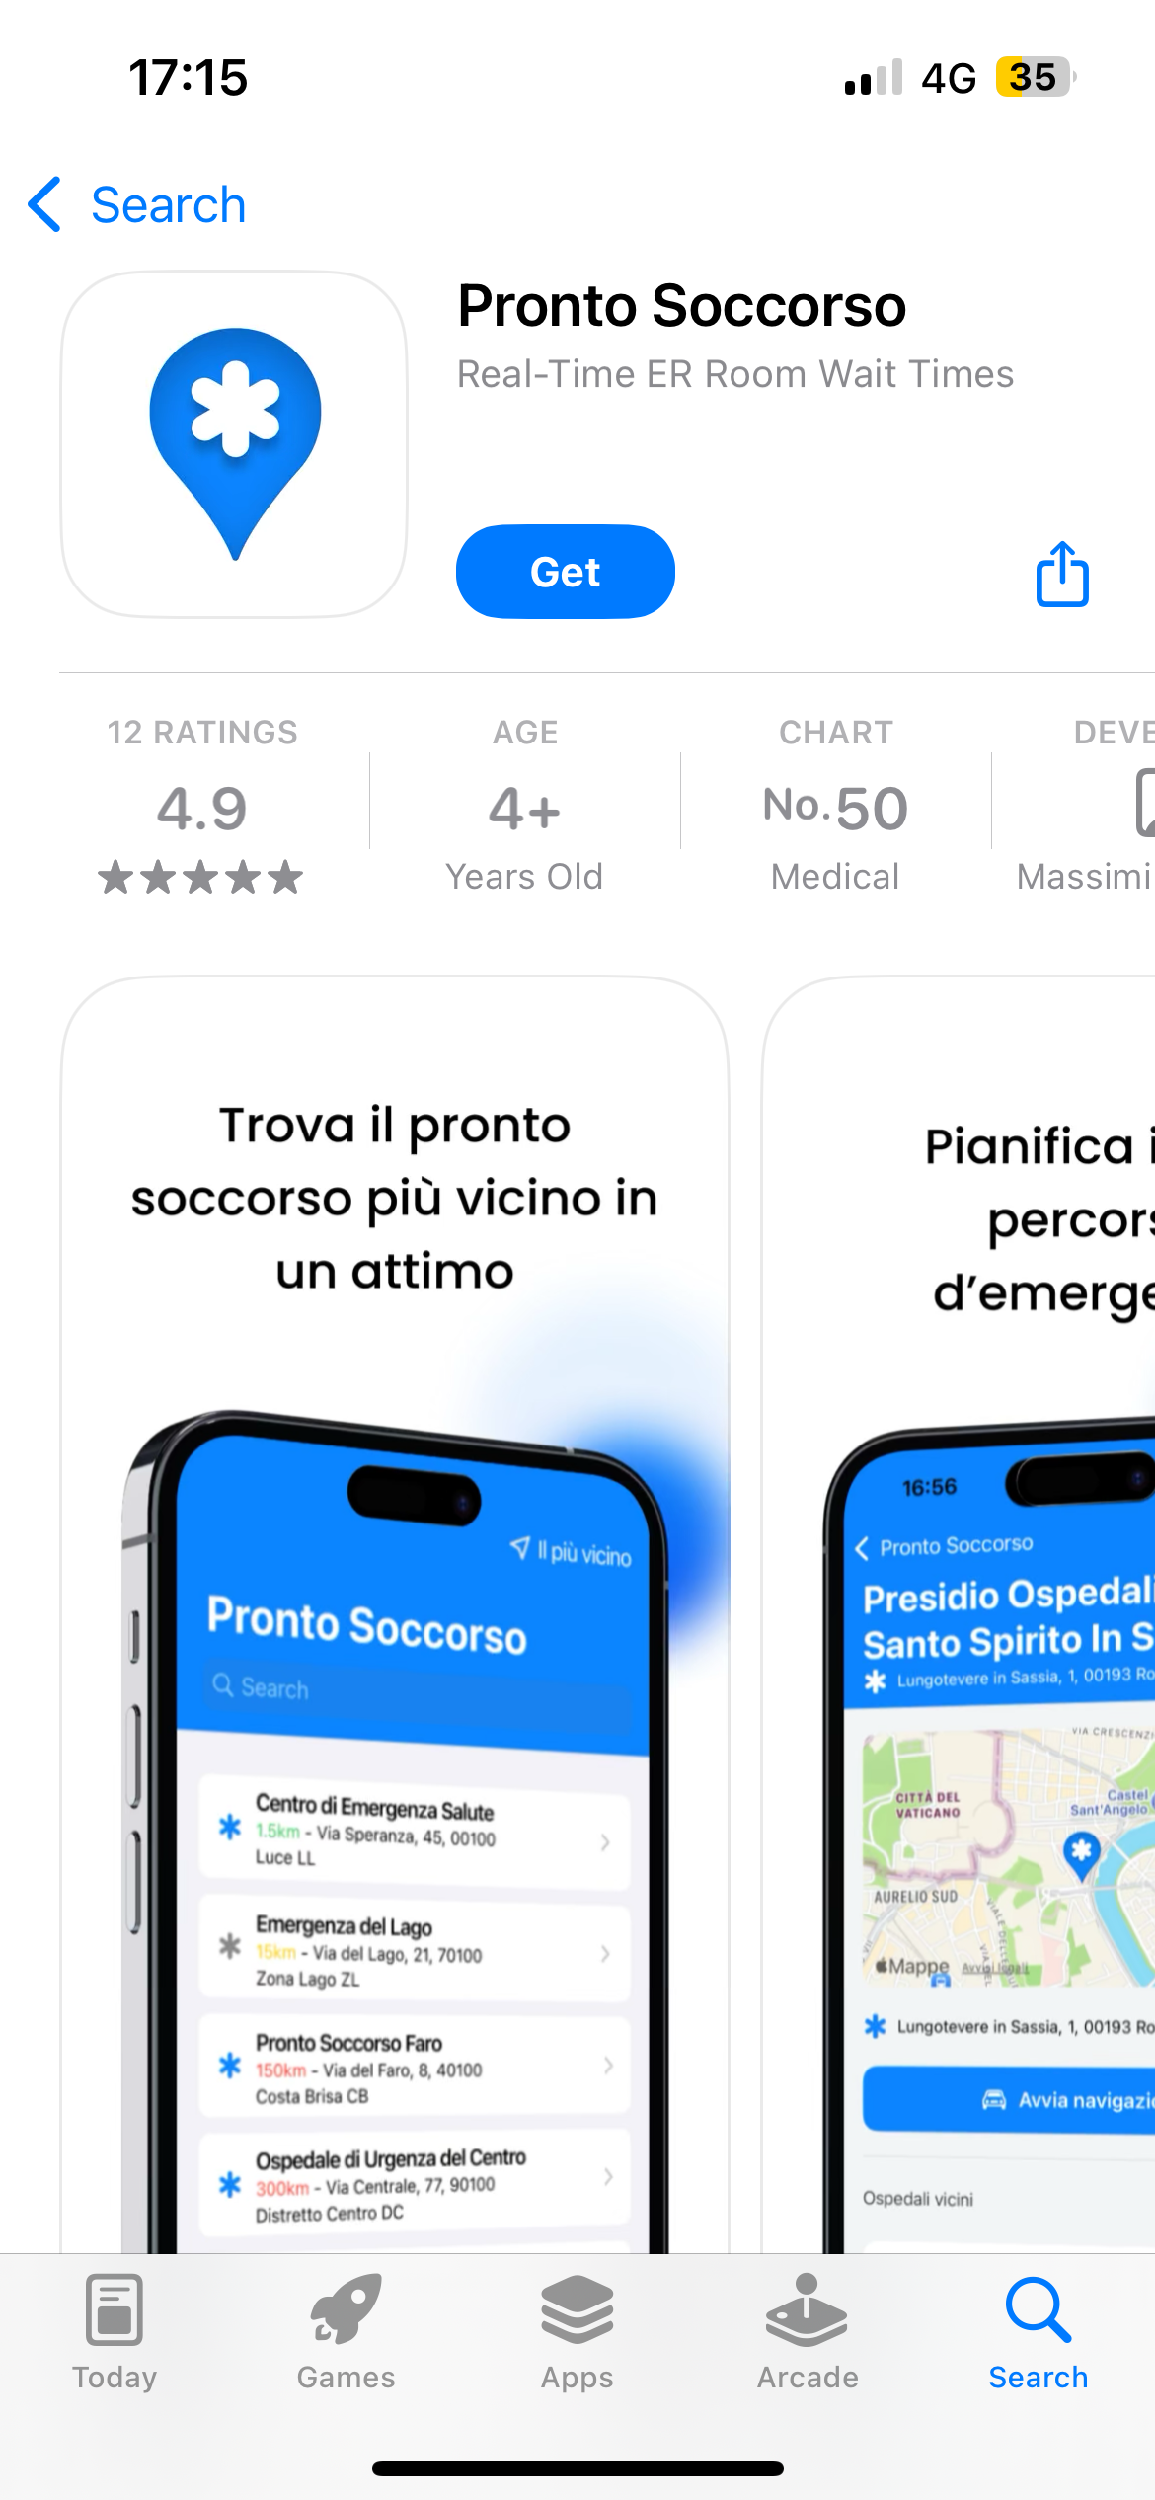
Existing Localization and Information Apps
MARKET SHARE OPPORTUNITY

Slide 7

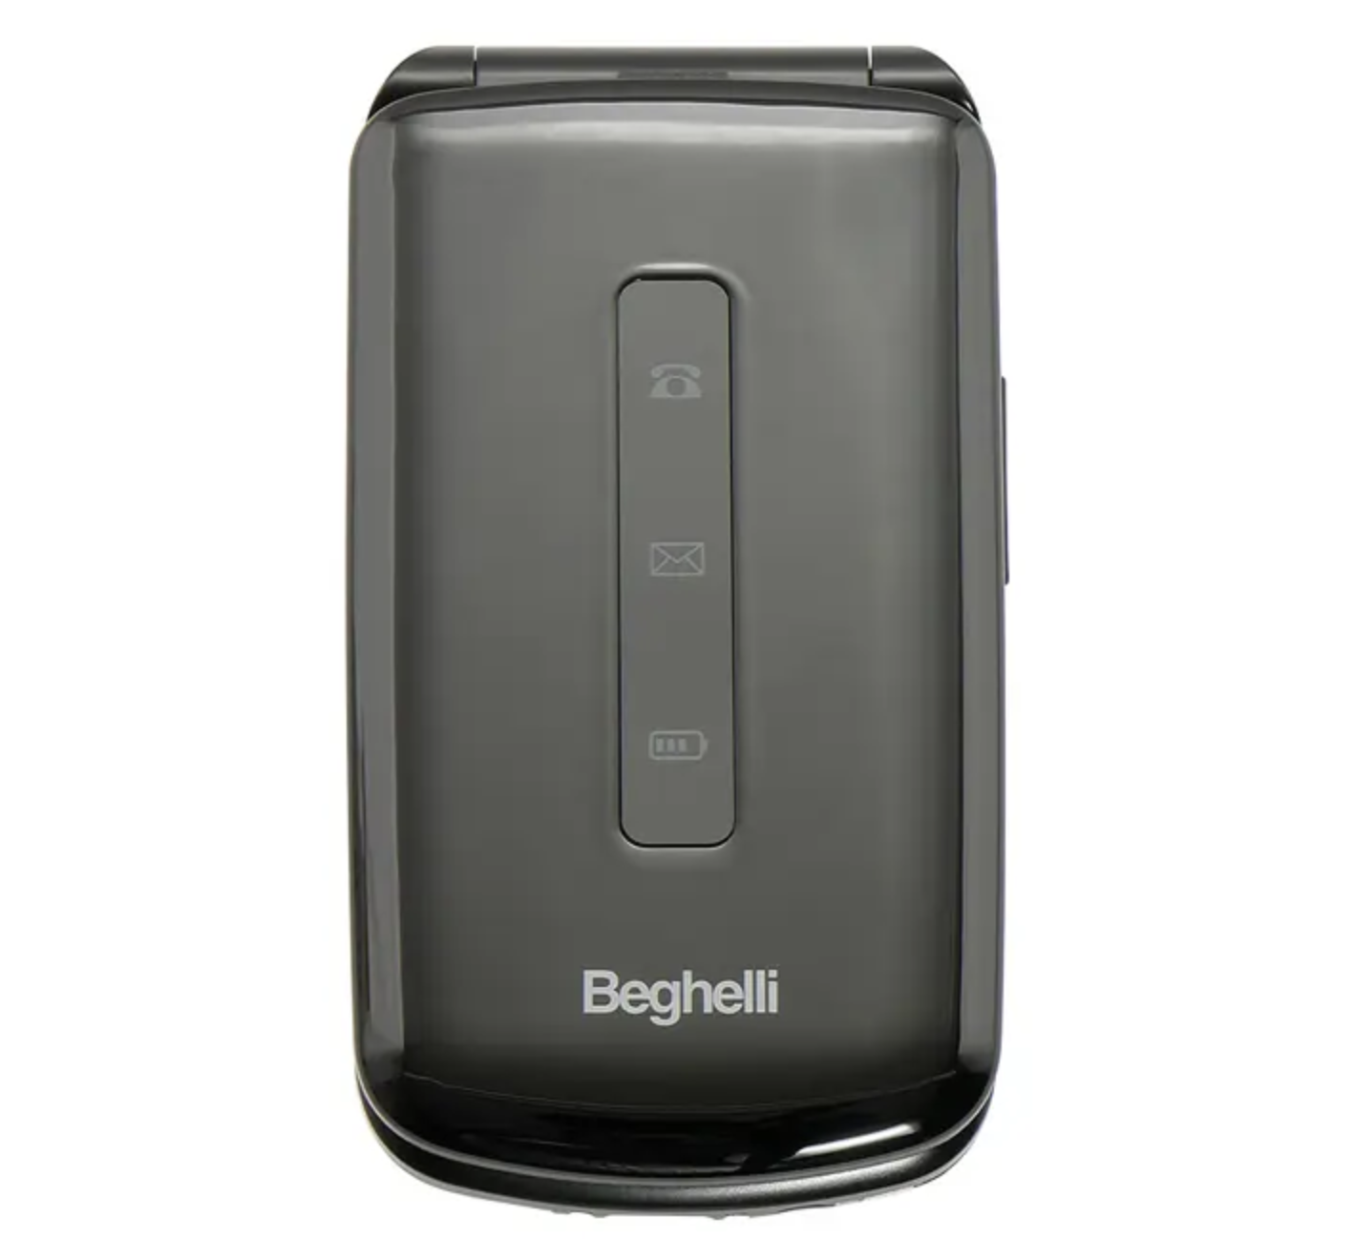
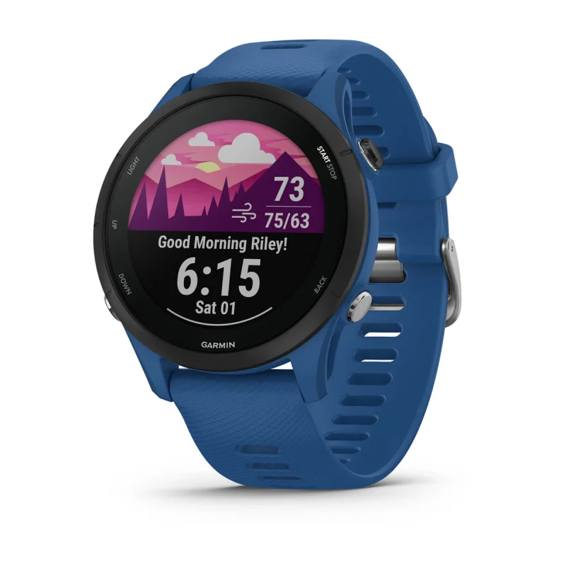
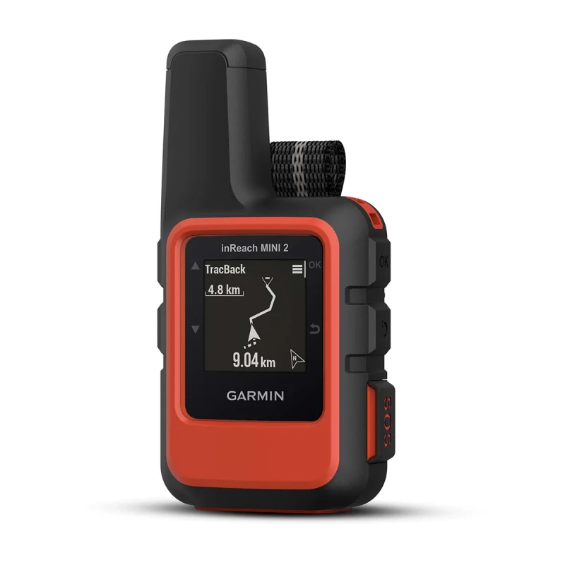
Existing Emergency and Satellite Services
BEGHELLI “SALVALAVITA” POCKET & PHONE
GARMIN FORERUNNER & INREACH
SYSTEM INTEGRATION OPPORTUNITIES

Slide 8






System Architecture

Slide 9
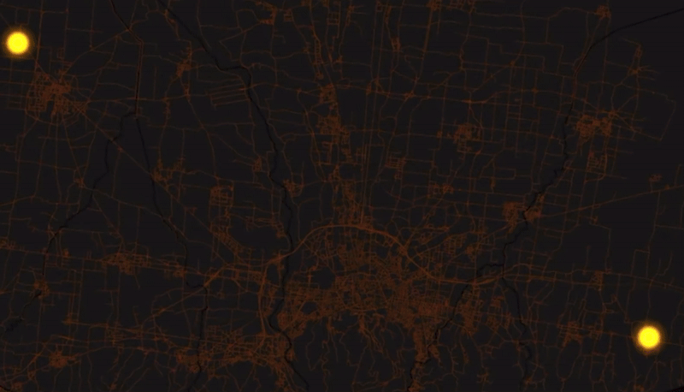
Data-Enhanced Path Finding Algorithm

Slide 10



Financing: European Ongoing Space Initiatives
IMERA (LAUNCH: MID 2026)
IRIS SQUARE (LAUNCH: 2030)
POTENTIAL FOR
EUROPEAN FUNDING

Slide 11





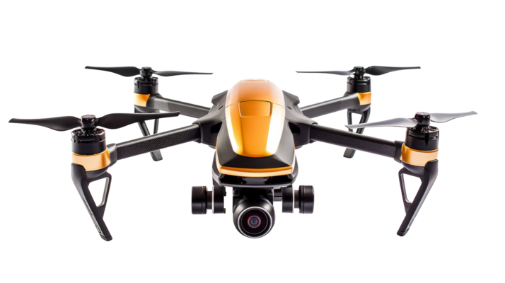


Roadmap 2025 - 2030
2030
2029
2028
2027
2026
2025

Slide 12


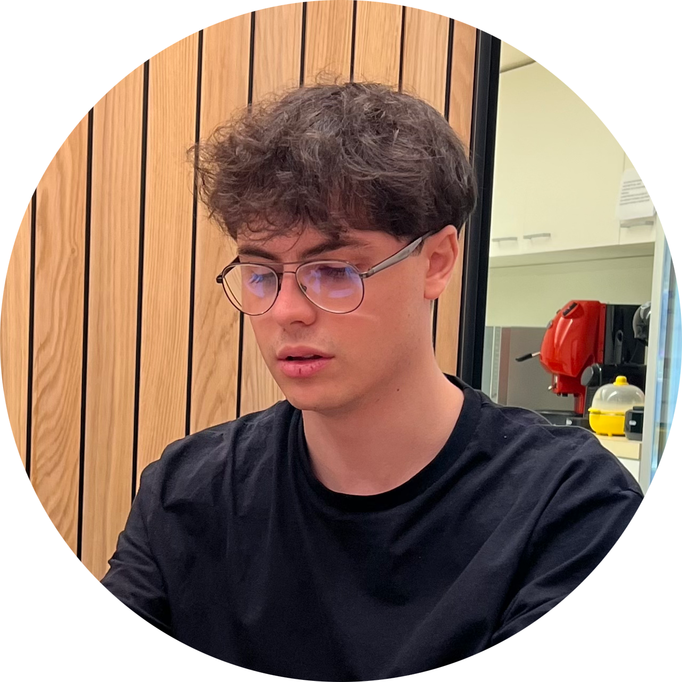


Our Team
ALESSIO PRATO
ALESSANDRO MARCELLINI
ALESSIO GANZAROLLI
B.Sc. student in Computer Science
UNIBO Motorsport Team Member
B.Eng. student in Computer Engineering
UNIBO Motorsport Team Member
Full-Stack Web Developer
B.Sc. student in Computer Science
NICOLA RICCI MACCARINI
LEONARDO PINNA
B.Sc. student in Computer Science
AI/ML Enthusiast
YouTube Content Creator
B.Sc. student in Computer Science

Slide 13
THANK YOU FOR YOUR ATTENTION!

